Slide 1
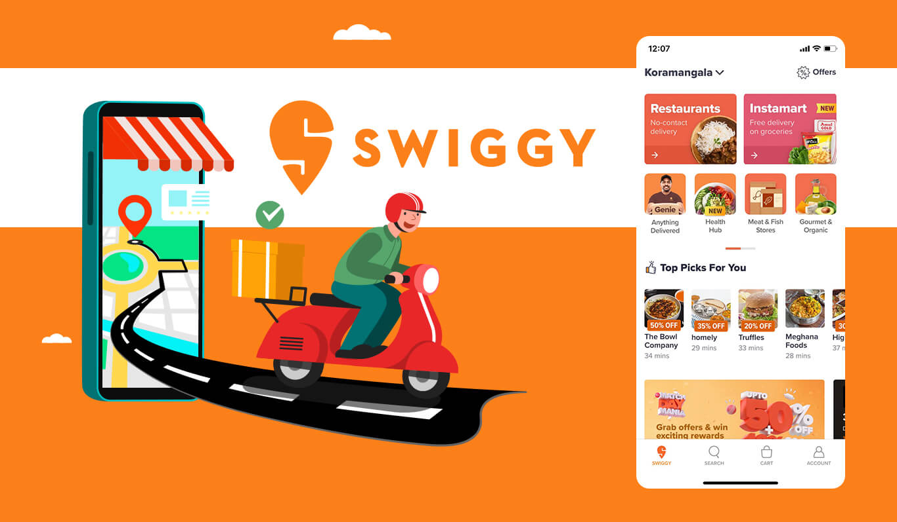
SWIGGY DATA ANALYSIS
Presented By:
Mayank Rai
Anish Katoch
Yasmeen Ustad
Akash Phatangare

Slide 2
Why This Project?
We have observed a trend towards remote kitchens in recent times, and as a data analyst, our task is to identify the best location for a remote kitchen based on the demand for different types of cuisines in the area. Our objective is to maximize customer satisfaction by providing high-demand cuisines while minimizing delivery time and costs.

Slide 3
Objectives
Scraped and analyze data from Swiggy website and presented in tables with specified details of columns.
Identify the most popular cuisines, as well as the geographic and demographic characteristics of the target area, based on a combination of customer demand, delivery time/cost, and other factors using historical order data
Found insights and created visualizations/Dashboard from the data.

Slide 4
INSIGHTS

Slide 5
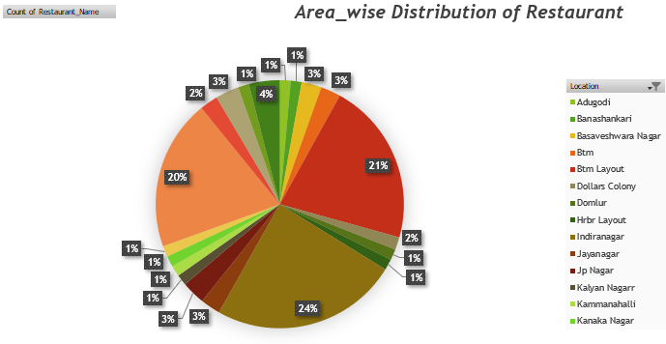
Area Wise Distribution of Restaurant
Maximum Restaurant Occupancy in Bangalore.
Indiranagar 24%
Btm Layout 21%
Koramangala 20%

Slide 6
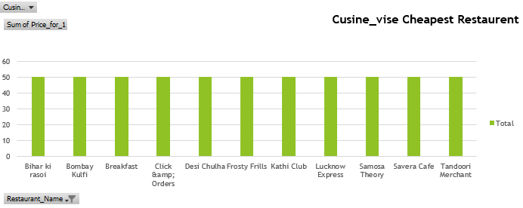
Cuisines Wise Cheapest Restaurant

Slide 7
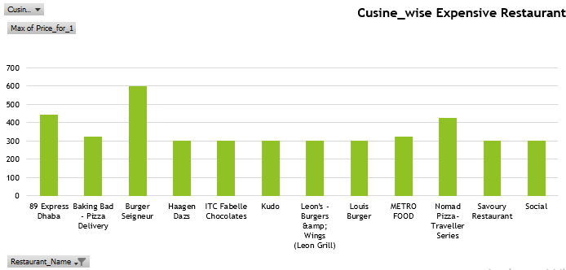
Cuisines Wise Expensive Restaurant

Slide 8
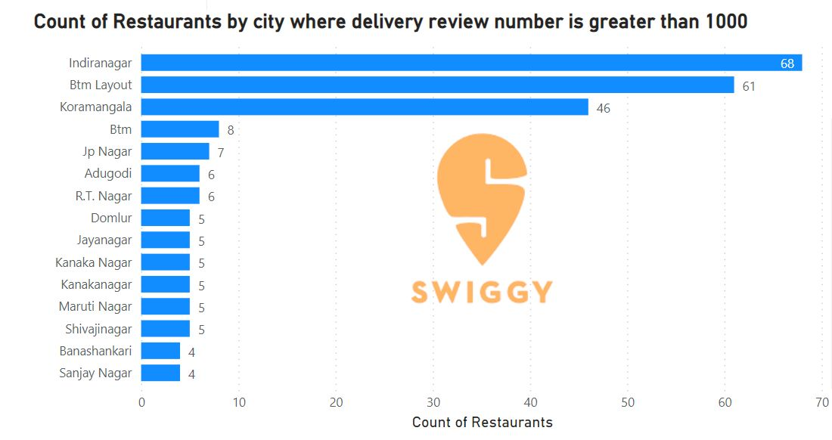
Maximum No Of Restaurant Where The Delivery Review Number Is Greater Than 1000
Indiranagar 68
Btm Layout 61
Koramangala47

Slide 9
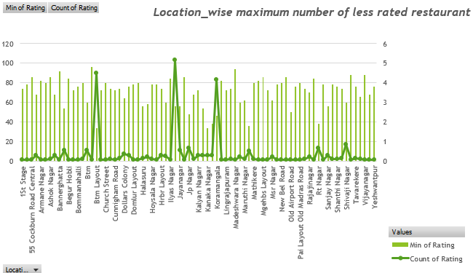
Location Wise Maximum Number Of Less Rated Restaurant
Indiranagar :- 103 , Btm Layout :- 90, Koramangala :- 83

Slide 10
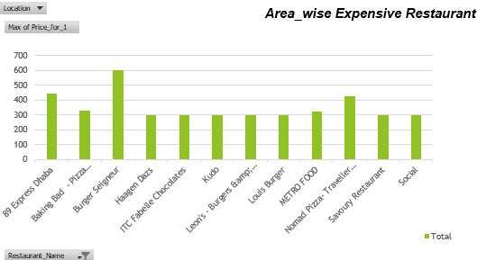
Area Wise Expensive Restaurant

Slide 11
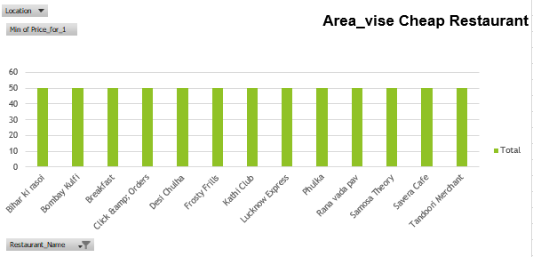
Area Wise Cheap Restaurant

Slide 12
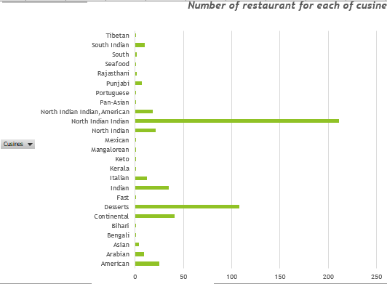
Number of Restaurant For Each Of Cuisine

Slide 13
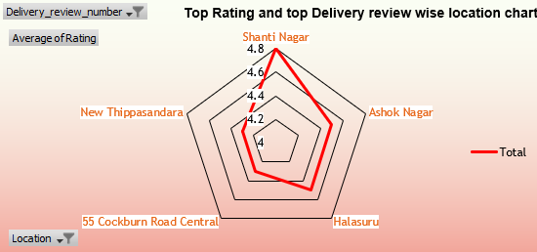
Best Location To Open a Restaurant
The best location to open a restaurant is Shanti Nagar due to its great delivery views and also has the highest average ratings.
High delivery views means there are more people in this area, and the total number of restaurants is also not high.

Slide 14
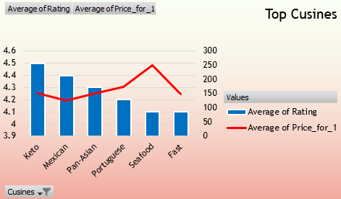
Top Cuisines
We have selected several cuisines to be available in our restaurant, including Keto for 150 rupees, Mexican for 125 rupees, Pan-Asian for 150 rupees, and Portuguese for 175 rupees. The average price for our menu items is competitive and designed to cater to a variety of tastes and budgets.

Slide 15
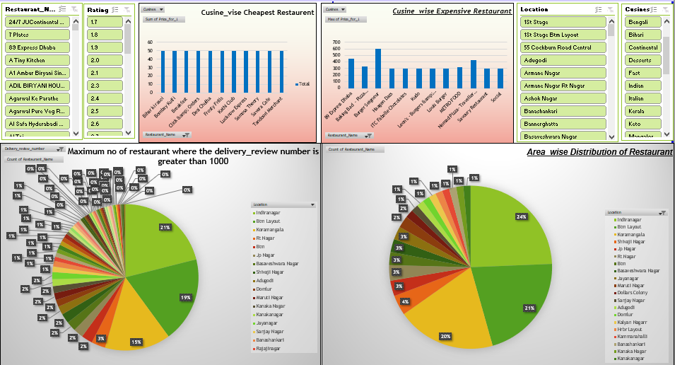
Swiggy Analysis Dashboard

Slide 16
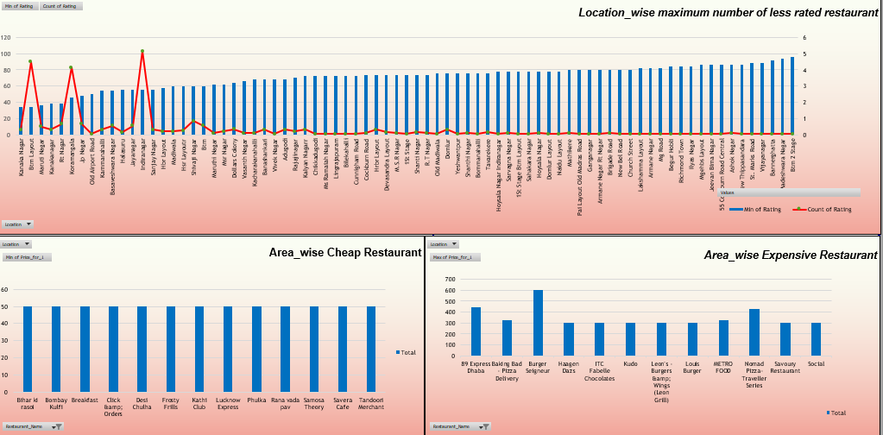

Slide 17

Challenges
Unable to scrape Swiggy data due to dynamic site.
Complex HTML.
Need to manage time efficiently.

Slide 18

Learning
Web scraping.
Basic understanding of HTML Script.
New Python library like Selenium and BeautifulSoup.
Effective teamwork and time management strategies.

Slide 19
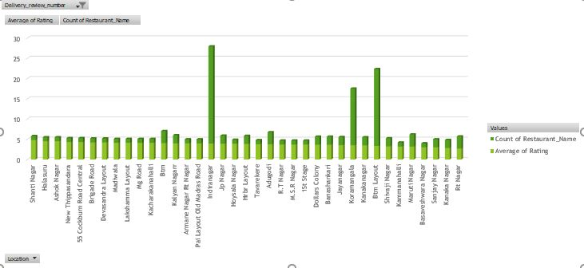
Future Scope
High-density areas such as Indiranagar, Koramangala, and BTM Layout have fewer highly-rated restaurants with high delivery reviews and fewer ratings.
A remote kitchen can be a promising opportunity to take advantage of the high delivery review ratings and the scarcity of existing restaurants.
This presents a potential opportunity for new restaurant openings.

Slide 20
THANK YOU

